Slide 1
Unsupervised Pre-training of Graph Neural Networks
Ziniu Hu
2/6/2019

Slide 2
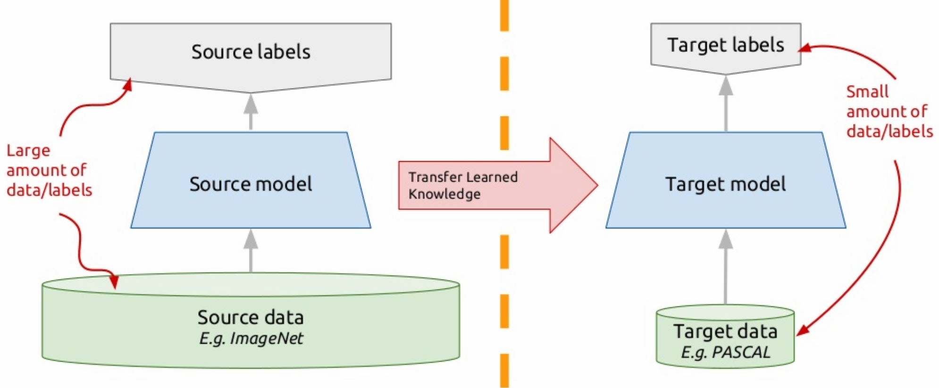
Why Unsupervised Pre-training
Data
Labelled data is limited
unsupervised data is abundant
Regularization
transfer knowledge from a related tasks

Slide 3
How to conduct pre-training in CV and NLP
Find Transferable Feature
RGB Pixels for images
Shared word embedding for a given language
Some tricks for multi-lingual texts
Find informative pre-training tasks
Supervised (Image-Net, Machine Translation)
Unsupervised (Language Model, Auto Encoder)
Fit on Downstream Tasks
Feature Extractor (ELMO)
Fine-Tune (BERT)

Slide 4
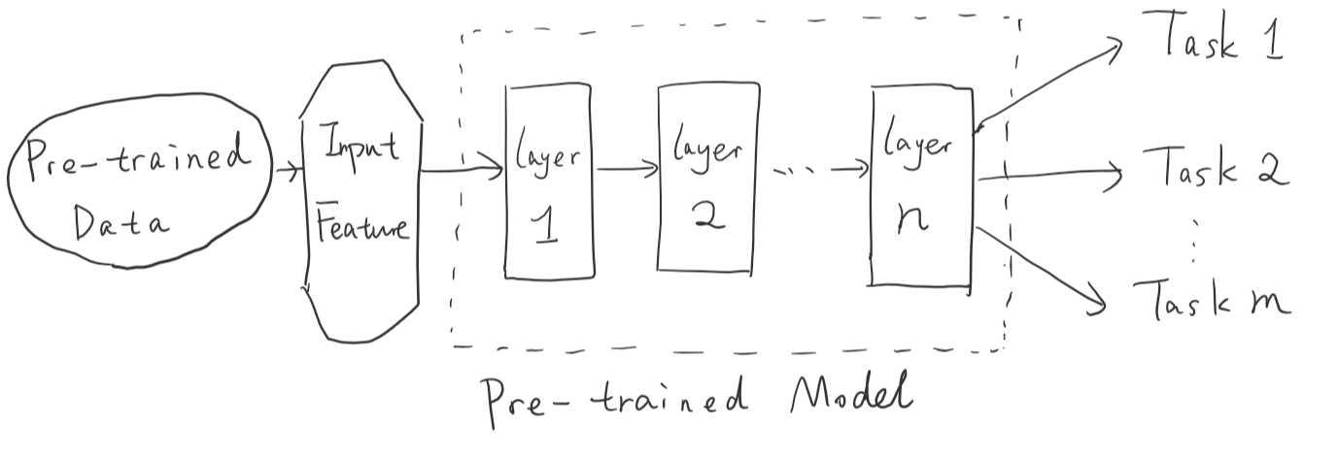
(Pre-train Stage)
(Adapt Stage)
Feature Extractor (ELMO)
Fine-Tune (BERT)

Slide 5
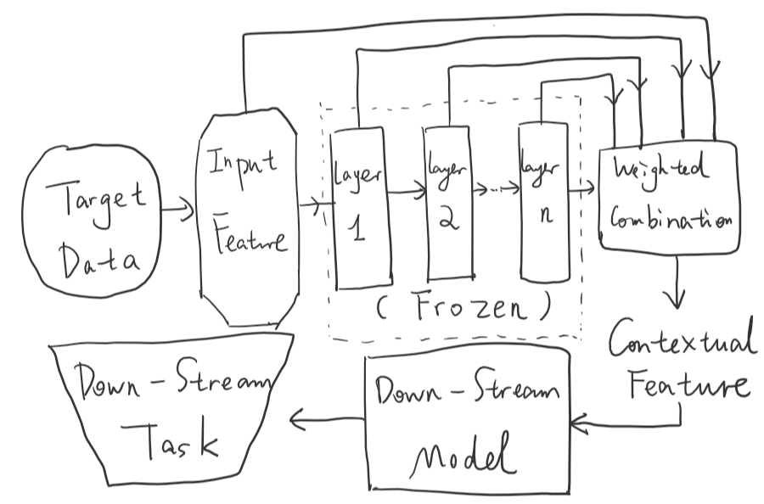
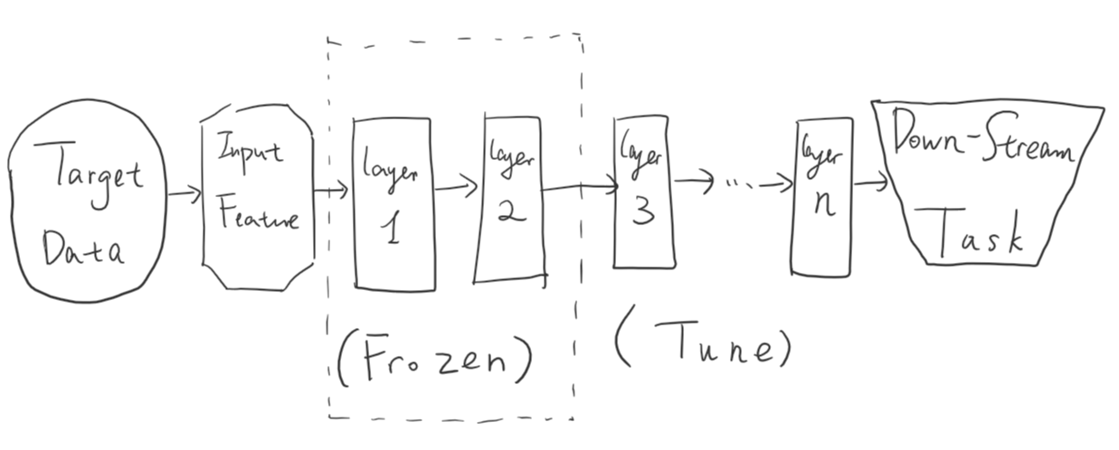
(Pre-train Stage)
(Adapt Stage)
Feature Extractor (ELMO)
Fine-Tune (BERT)

Slide 6
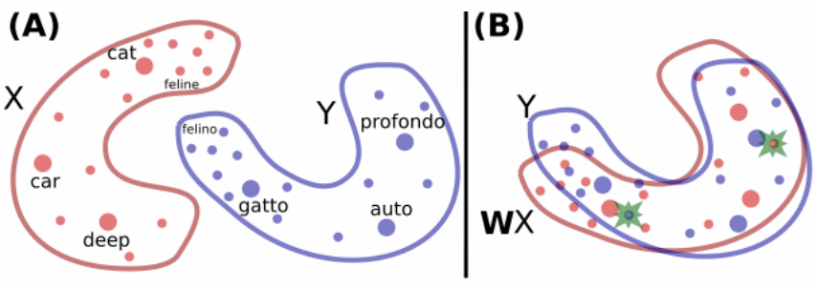
A special Case: Multilingual Embeddings
With Parallel Data
Without Parallel Data
Unsupervised approach (ICLR’18 Word Translation Without Parallel Data)
A discriminator to predict which language a given vector belongs to (X or Y)
Training the linear transformation W so that the discriminator is unable to accurately predict.
Refine by further minimizing distance on frequent word pairs.
Pre-training approach (Cross-lingual Language Model Pretraining)
Use pre-train tasks to learn such transformation.
Share the pre-trained model, diff on transformation layer.

Slide 7
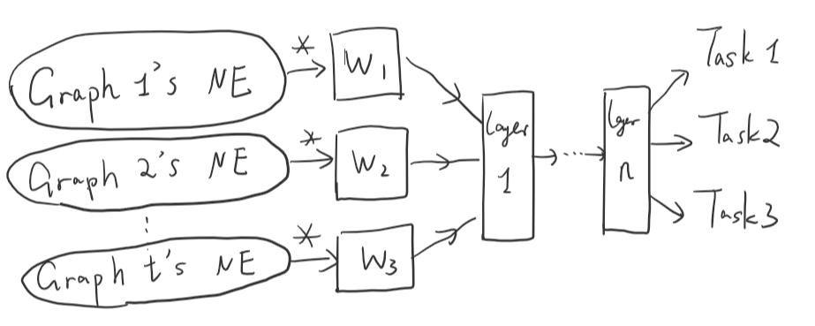
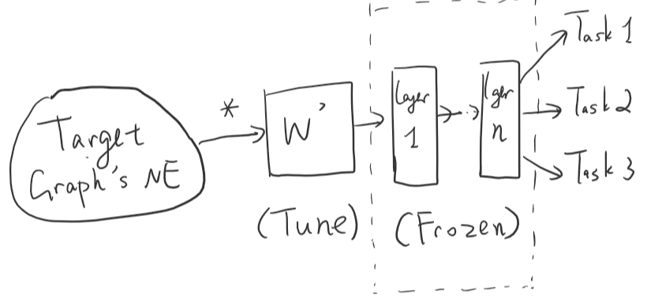
Pre-training for GNN
Find Transferable Feature
Current datasets normally have ad-hoc features
Proper unsupervised features:
Degree, Local Cluster coefficience, graph kernel, etc
Node Embedding (Naturally Transudative. Whether can we align?)
Ad-hoc features (Future work, challenging)
Whether can we align them to get universal representation too?

Slide 8
Pre-training for GNN
Find informative pre-training tasks
Local Structure:
Graph Reconstruction (Masked Link Prediction)
Global Structure:
Ranking Estimation of Closeness, PageRank, Degree
Graph-level Structure:
Graph Edit Distance

Slide 9
Pre-training for GNN
Fit on Downstream Tasks
Have tried both fine-tuning and feature extractor
Change to extreme scares setting (5% train; 5% valid; 90% test)
For degree, fine-tune can enhance about 3-4%, while feature extractor can enhance 10-14%.
Degree Feature | Downstream Tasks | No Pretrain | Random Graph (Finetune) | Random Graph (Feature Extractor)
Reconstruction | Cora (Node Classification) | 0.565 ± (0.010) | 0.590 ± (0.009) | 0.639 ± (0.014)
 | Movie (Link Classification) | 0.535 ± (0.008) | 0.587 ± (0.008) | 0.603 ± (0.011)
Rank | Cora (Node Classification) | 0.565 ± (0.010) | 0.571 ± (0.007) | 0.586 ± (0.008)
 | Movie (Link Classification) | 0.535 ± (0.008) | 0.576 ± (0.006) | 0.593 ± (0.009)
Rec + Rank | Cora (Node Classification) | 0.565 ± (0.010) | 0.588 ± (0.011) | 0.632 ± (0.013)
 | Movie (Link Classification) | 0.535 ± (0.008) | 0.591 ± (0.009) | 0.609 ± (0.012)

Slide 10
Pre-training for GNN
Fit on Downstream Tasks
For node2vec, fine-tune can enhance about 1%, while feature extractor can enhance 2%. (Using feature, cora is 0.82)
It shows that feature extractor is more effective to current GCN, maybe because the pre-train layer is not enough (but can train a deep NN when adding self-attention, skip connection, etc).
Node2vec | Downstream Tasks | No Pretrain | Random Graph (Finetune) | Random Graph (Feature Extractor)
Reconstruction | Cora (Node Classification) | 0.779 | 0.784 | 0.791
 | Movie (Link Classification) | 0.736 | 0.741 | 0.748
Rank | Cora (Node Classification) | 0.779 | 0.789 | 0.796
 | Movie (Link Classification) | 0.736 | 0.747 | 0.753

Slide 11
Can help train deeper network

Slide 12
Contribution of this work
Propose three unsupervised pre-training and show that they can benefit down-stream tasks with simple universal features.
Propose a pre-trained based alignment approach to align network embedding on different graphs, and show sota result compared even to useful features.
Show that feature extractor is efficient to current GCN + pretraining setting.

Slide 13
Future work
How to align representation of different feature domains (image, text, tag, node embedding, etc).
Design more complicated GNN that can utilize advanced tricks, including self-attention, skip connection, etc.

Slide 14
Submission Plan
ICLR’19 Workshop: Representation learning on graphs and manifolds
DDL: 3.22
4 pages (article) + 4 pages (ref + appendix)
Goal:
Finish core experiment (3 pretrain * 10 down-stream)
train deeper? (whether deeper pre-train can enhance performance.
NIPS’19
DDL: 5.18 (last year’s ddl)
Goal:
Try different alignment method for node embedding
Try best to add in different feature alignment

